Slide 1

CSC 533: Privacy in the Digital Age (Fall 2020) Lecture 20: Privacy Perception (Westin's Privacy Index)
Anupam Das
Oct. 27, 2020

Slide 2
Goals for today
Describe why it’s useful to segment users by privacy attitudes
Understand pros and cons of Westin’s approach to privacy segmentation
Do privacy preferences and behaviors align?
Some slide contents taken from Özgür Kafalı

Slide 3
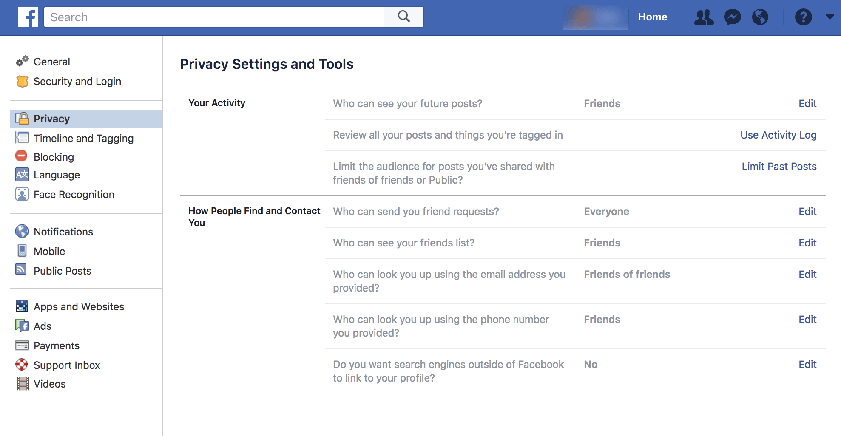
Why do we have privacy settings?
People have different privacy requirements
But settings are lengthy, complicated, at time boring ...

Slide 4
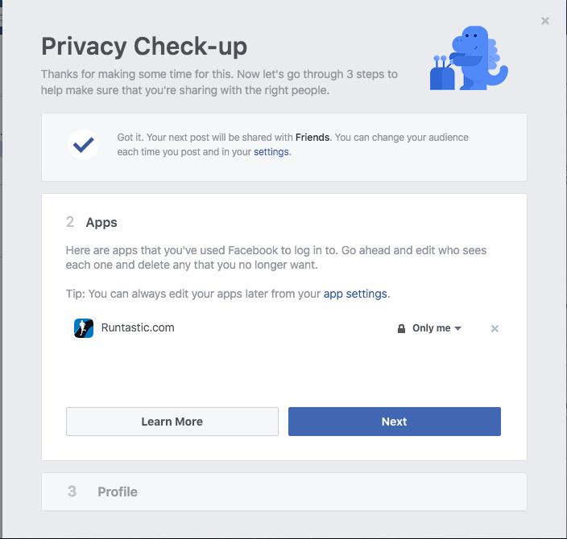
How can we help users manage their privacy settings?
Privacy assistants step users through key settings
But how can assistants understand my needs?

Slide 5
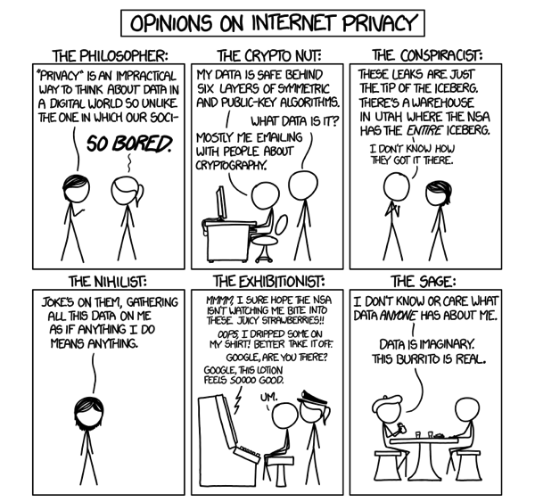
Different personas?
Privacy assistants step users through key settings
Research Question: Can we cluster users based on their perception of privacy?

Slide 6
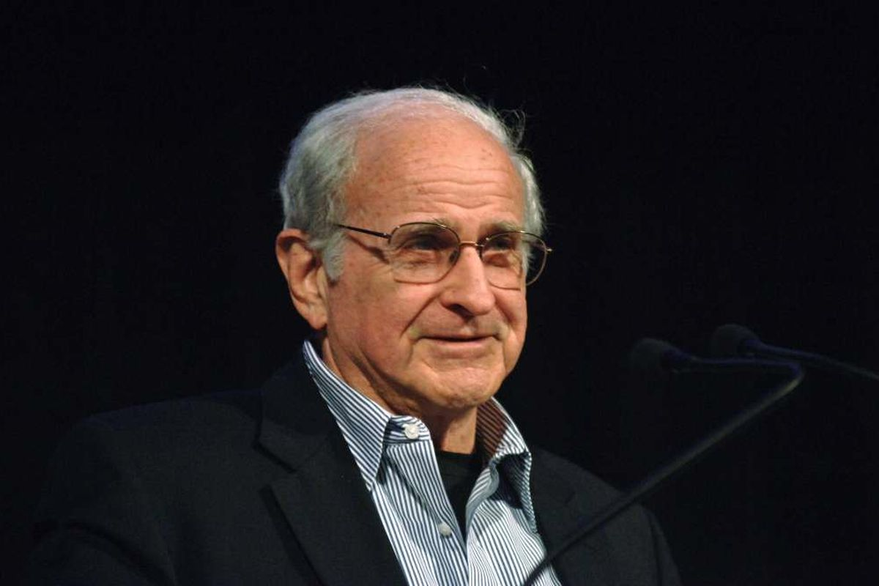
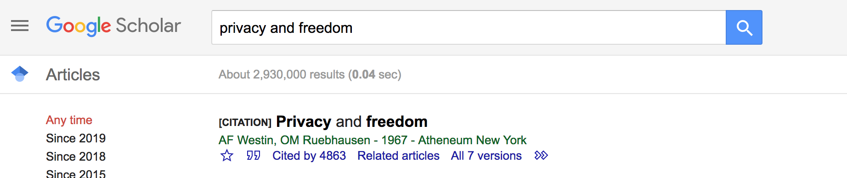
Alan Westin: Privacy Segmentation
Alan Westin half a century ago defined the modern right to privacy before the Web era
Three categories: Fundamentalist, pragmatist, unconcerned
Alan Furman Westin a Professor of Public Law

Slide 7
Westin's privacy index survey
Q1: Consumers have lost all control over how personal information is collected and used by companies. *
Strongly disagree
Somewhat disagree
Somewhat agree
Strongly agree
Q2: Most businesses handle the personal information they collect about consumers in a proper and confidential way. *
Strongly disagree
Somewhat disagree
Somewhat agree
Strongly agree
Q3: Existing laws and organizational practices provide a reasonable level of protection for consumer privacy today. *
Strongly disagree
Somewhat disagree
Somewhat agree
Strongly agree
Users lost control
Companies care about consumer
Existing laws are enough

Slide 8
Westin’s Privacy Segmentation
Fundamentalist: Agree (strongly or somewhat) with “Consumers lost control . ”; AND Disagree (strongly or somewhat) with “Most businesses care about consumers. . . ”; AND Disagree (strongly or somewhat) with “Existing laws are enough . . . ”.
Unconcerned: Opposite of fundamentalist: Disagree, agree, agree
Pragmatist: Anyone who is not a fundamentalist or unconcerned

Slide 9
Applications of Westin’s Survey
Conduct human subject research on privacy
Compare reported attitude vs. actual privacy related actions
Organizations might use this data to target pragmatists
Provides insights for organizations to respond to privacy concerns with appropriate policies, products, and services

Slide 10
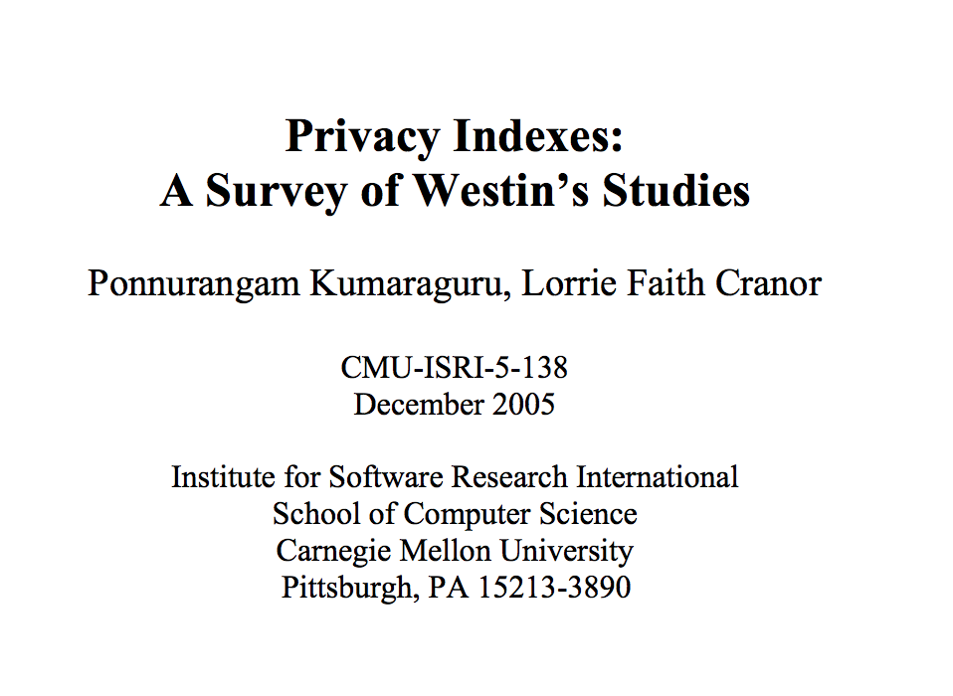
Privacy Indexes: A Survey of Westin’s Studies
Westin conducted over 30 privacy-related surveys between 1978 and 2004
Surveys cover general privacy, consumer privacy, medical privacy, etc.
Created a “Privacy Index” to summarize results and show trends in privacy concerns
This study looked at 14 surveys (some are not available even in paper format today)

Slide 11
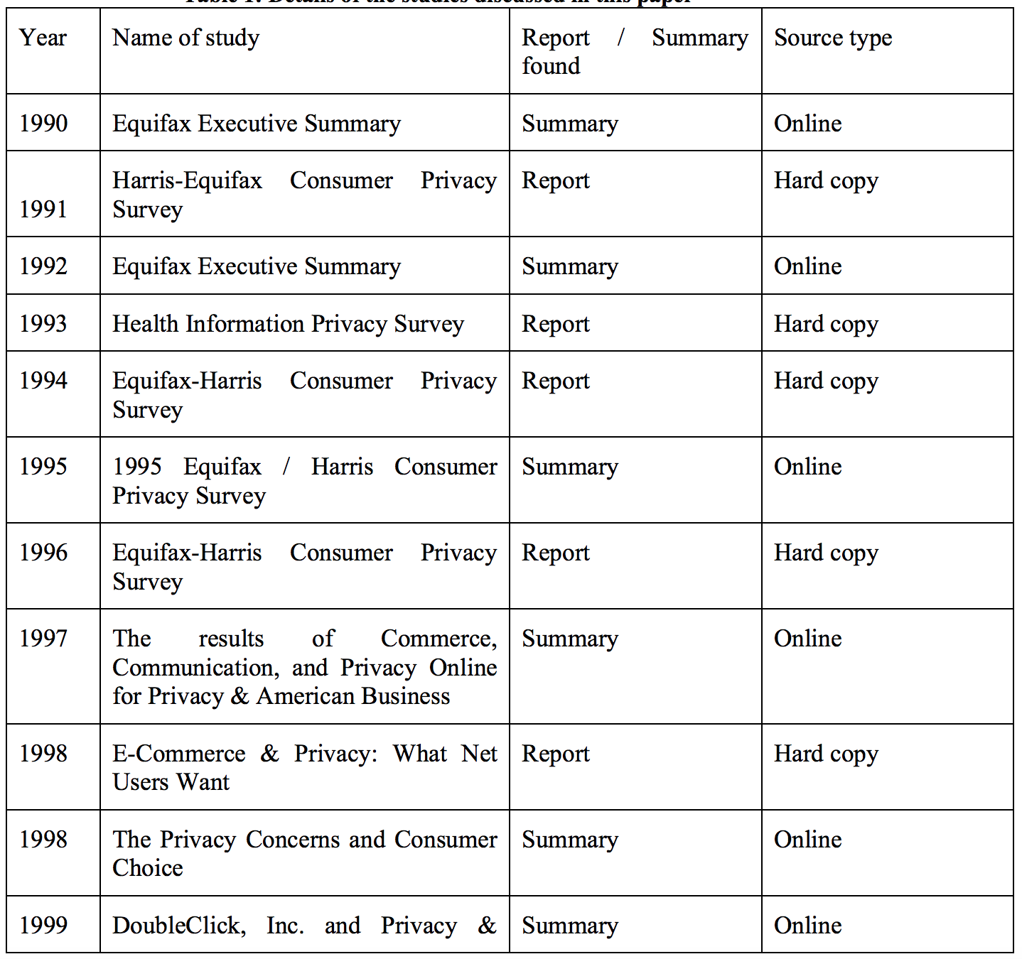
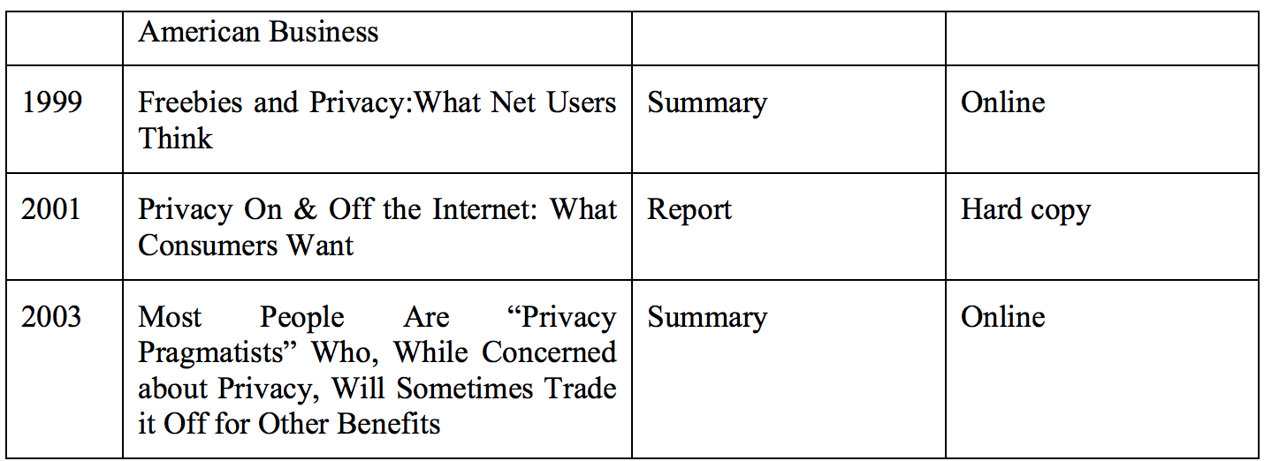
Summary of Surveys
14 surveys
Around 100 participants

Slide 12
General Privacy Concern Index
Harris - Equifax Consumer Privacy Survey (1990 and 1991)
The short survey asked four questions:
Whether they are very concerned about threats to their personal privacy today
Whether they agree strongly that business organizations seek excessively personal information from consumers
Whether they agree strongly that the Federal government since Watergate is still invading the citizen’s privacy
Whether they agree that consumers have lost all control over circulation of their information
Notes:
Watergate scandal in 1972

Slide 13
General Privacy Concern Evaluation
High: 3 or 4 privacy-concerned answers ( fundamentalists)
Most privacy concerned. Fundamentalists are the most protective of their privacy. Believes in new laws to spell out privacy rights and proper enforcements.
Moderate: 2 privacy-concerned answers (pragmatist)
Pragmatists weigh the potential pros and cons of sharing information, and evaluate the protections that are in place and their trust in the company or organization.
Low: 1 or no privacy-concerned answers (unconcerned)
These consumers are the least protective of their privacy – they feel that the benefits they may receive from companies after providing information far outweigh the potential abuses of this information.

Slide 14
General Privacy Concern Evaluation
Type | Percentage
Fundamentalist
Pragmatist
Unconcerned
25%
57%
18%

Slide 15
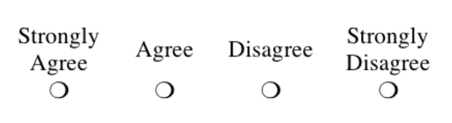
Consumer Privacy Concern Survey
The two-question survey (1991) asked participants to agree/disagree with the following statements:
Consumers have lost all control over how personal information about them is circulated and used by companies
My privacy rights as a consumer in credit reporting are adequately protected today by law and business practices
4 point Likert scale

Slide 16
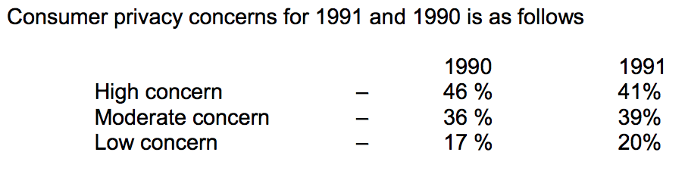
Consumer Privacy Concern Index
Low concern: Not take the privacy-oriented position on either of the statements
Moderate concern: Take one of the two pro-privacy views
High concern: Take the strongest privacy-oriented position on both of the statements

Slide 17
Computer Fear Survey
Part of the 1993 study, Westin also created the “Computer Fear Index”
Included the following questions and statements:
If privacy is to be preserved, the use of computers must be sharply restricted in the future
How concerned are you that many health care providers you use today employ computers in some of their operations, such as patient billing and accounting, laboratory work, and keeping some medical records?
Under national health care reform, computers are expected to be used extensively to manage and monitor operations. Some of these uses will involve individual medical records. In general, would such use of computers worry you?
Notes:
Just after the Web (1990-1991) was released

Slide 18
Computer Fear Index
High concern: 2-3 privacy-concerned answers
Moderate concern: 1 privacy-concerned answers
Low concern: no privacy-concerned answers
High | 22%
Medium | 32%
Low | 47%

Slide 19
Medical Sensitivity Survey
Harris-Equifax Health Information Privacy Survey (1993)
Included the following questions and statements:
It concerns me that my medical information is being seen today by many organizations beyond those that I use for healthcare
Under national health-care reform, each person might be assigned an identification number for health insurance purposes. How concerned would you be to have such a health information number assigned to you?
How concerned are you that many health care providers you use today employ computers in some of their operations, such as patient billing and accounting, laboratory work, and keeping some medical records?
Under national health care reform, computers are expected to be used extensively to manage and monitor operations. Some of these uses will involve individual medical records. In general, would such use of computers worry you?

Slide 20
Medical Sensitivity Index
High: 3-4 privacy-concerned answers
Moderate concern: 1-2 privacy-concerned answers
Low: no privacy-concerned answers
High | 13%
Medium | 45%
Low | 42%

Slide 21
Distrust Index
Equifax-Harris consumer privacy report (1994)
Agree/disagree to the following statements:
Technology has almost gotten out of control
Government can generally be trusted to look after our interests
The way one votes has no effect on what the government does
In general business helps us more than harm us
High distrust (3-4 distrustful answers) | 31%
Medium Distrust (2) | 38%
Low distrust (1) | 26%
No distrust (0) | 5%
Notes:
Important things happening between 1990-1994
WWW become an internet service
Gulf war is waged

Slide 22
Final Survey (2003): Question 1
Users have lost control of their data
Harris Privacy Survey – 2003
Consumers have lost all control over how personal information is collected and used by companies
69% of adults agree: A decline of eleven points from 80% who felt this way in 1999

Slide 23
Final Survey (2003): Question 2
Companies care about their consumers
Most businesses handle the personal information they collect about consumers in a proper and confidential way
54% of the public disagree: An increase of nineteen points from only 35% who felt this way in 1999

Slide 24
Final Survey (2003): Question 3
There are enough existing laws to regulate privacy
Existing laws and organizational practices provide a reasonable level of protection for consumer privacy today
53% of all adults disagree: An increase of fifteen points from 38% in 1999

Slide 25
Privacy Orientation Index over time
Type | 1995-1999 | 2000 | 2001 | 2003
Fundamentalist | 25% | 25% | 34% | 26%
Pragmatist | 55% | 63% | 58% | 64%
Unconcerned | 20% | 13% | 8% | 10%
What can we say about the trend?

Slide 26
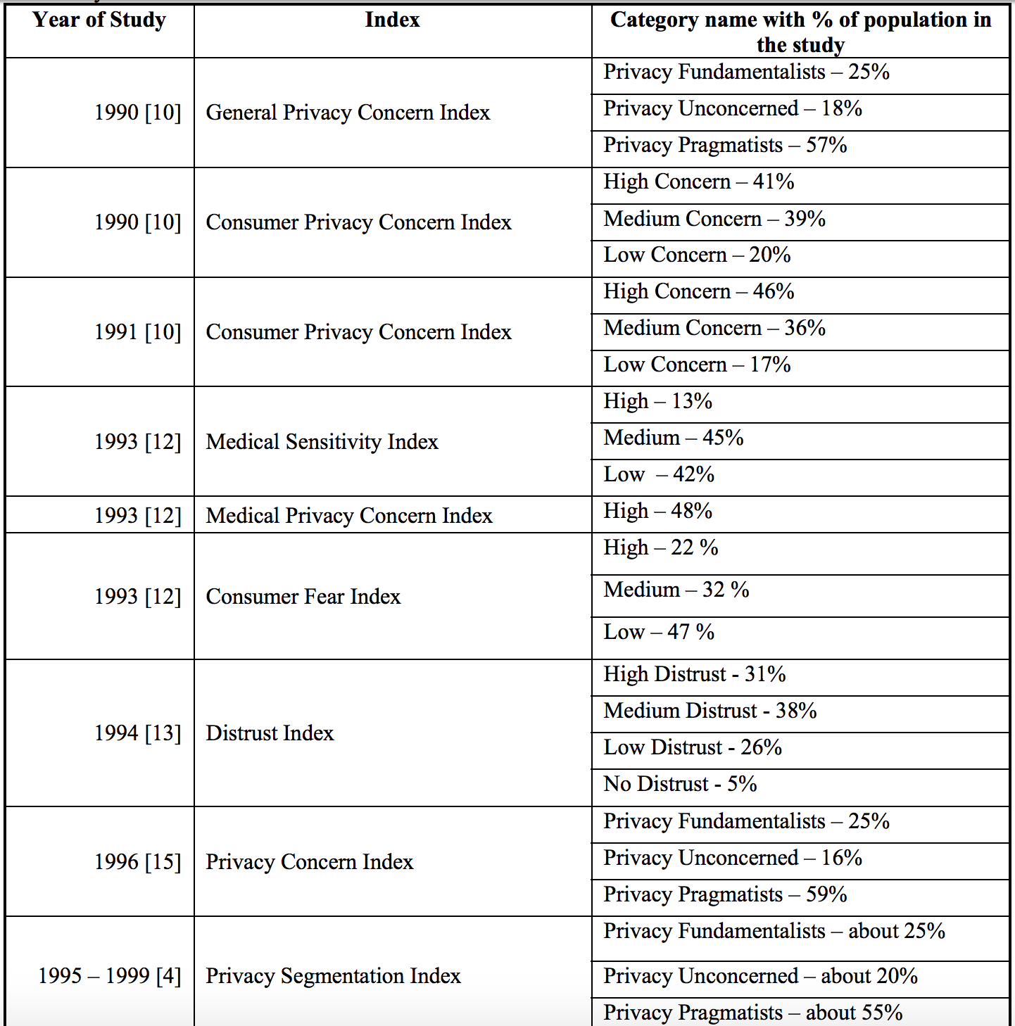
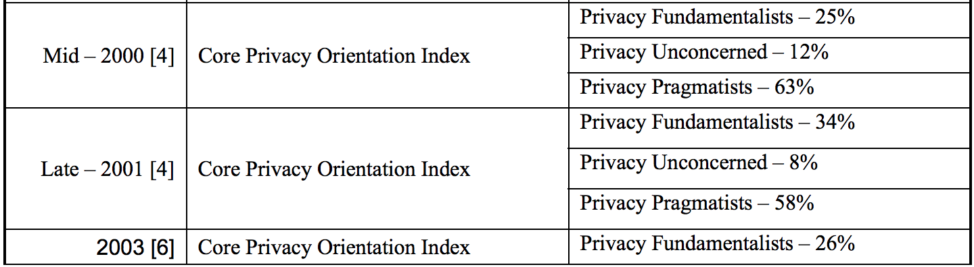
Summary of Categories Over Time

Slide 27
Criticisms
Electronic Privacy Information Center (EPIC) called Westin’s ‘Fundamentalist’ category ‘pejorative’
They argued being a fundamentalist is reasonable and not to be seen as being paranoid about privacy issues

Slide 28
Limitations of Westin’s Segmentation
Unclear if Westin’s categories (broad, generic privacy attitudes) and context-specific privacy behaviors (actual or intended) align
Unstated assumptions underlying the categories: Presumes individuals make rational and informed privacy decisions
Not obvious if all concerns/questions remain current in our ever connected digital world

Slide 29
Misalignments with Westin’s Privacy Index
Numerous studies on attitude–behavior dichotomy (Privacy Paradox)
General survey questions vs. context-specific scenarios
Participants do not live up to their self-reported privacy preferences
Online shopping and other hypothetical e-commerce scenarios
What participants say they care vs. what they post on Facebook
Location based services
Law enforcement’s access to cell phone data

Slide 30
Alternatives Privacy Scales
More specific questions
Internet Users’ Information Privacy Concerns (IUIPC)
Privacy Concern Scale (PCS)
Scenario based, focus group discussions:
Surveillance
Location tracking
Photo sharing
Self-disclosure/relationship building
Identity theft
Health disclosure

Slide 31
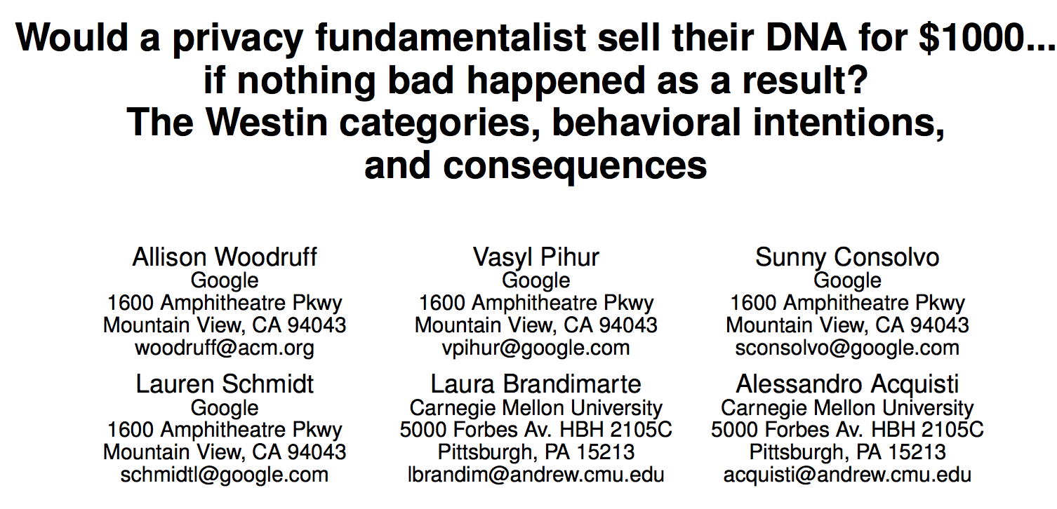
Westin category and behavioral intents
Explore the connection between Westin categories and individuals’ responses to consequences of privacy behaviors
Is there a correlation between Westin categories and behavioral intent?
Is there a correlation between Westin categories and consequences?

Slide 32
Study design
Two-phase study
Phase I:
Survey that includes measures of general privacy attitudes
Survey on personal characteristics (psychology literature)
Phase II:
Participants imagine themselves in three randomly chosen scenarios (out of 20)
Financial
Health
Location
Social

Slide 33
DNA Scenario
Outcomes
Your medical data is combined with that of many others. It is used to find a new cure for a previously deadly disease. Neither you nor anyone in your family has this disease.
Your data is published with information that identifies you. You lose a job due to your genetic information, which falsely suggests you may later develop a serious medical condition.
Your data is used to calculate the probability of certain diseases developing within your family. As a result, some of your relatives (but not you) see an increase of several hundred dollars a year in their health insurance premiums.
Your test results reveal that you have a serious but treatable disease of which you were previously unaware. You receive treatment just in time to make a full recovery
Scenario
A marketing company offers you $1000 and free genetic testing in exchange for the rights to all your current and future medical records. They will have the right to resell or publish your data (anonymously or with information that could identify you, at their discretion)
Presented the participants with three outcomes (randomly chosen) for each scenario
Positive, negative, and neutral implications for privacy and well-being

Slide 34
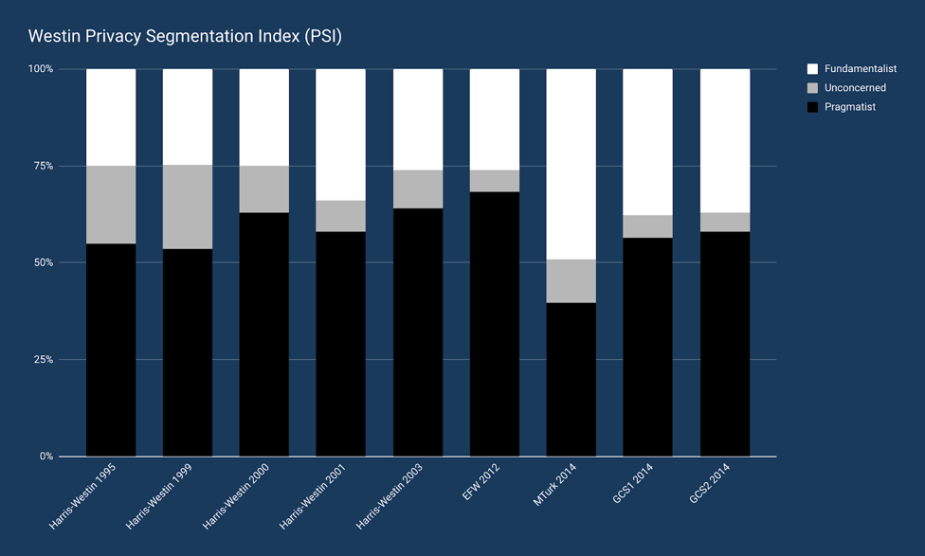
Distribution of Westin Categories
Google Consumer Surveys (GCS)
GCS1 (same questions as Westin)
GCS2 (were asked additional questions regarding privacy questions for specific brands)
Amazon, PayPal, Safeway, Visa, and Walmart

Slide 35
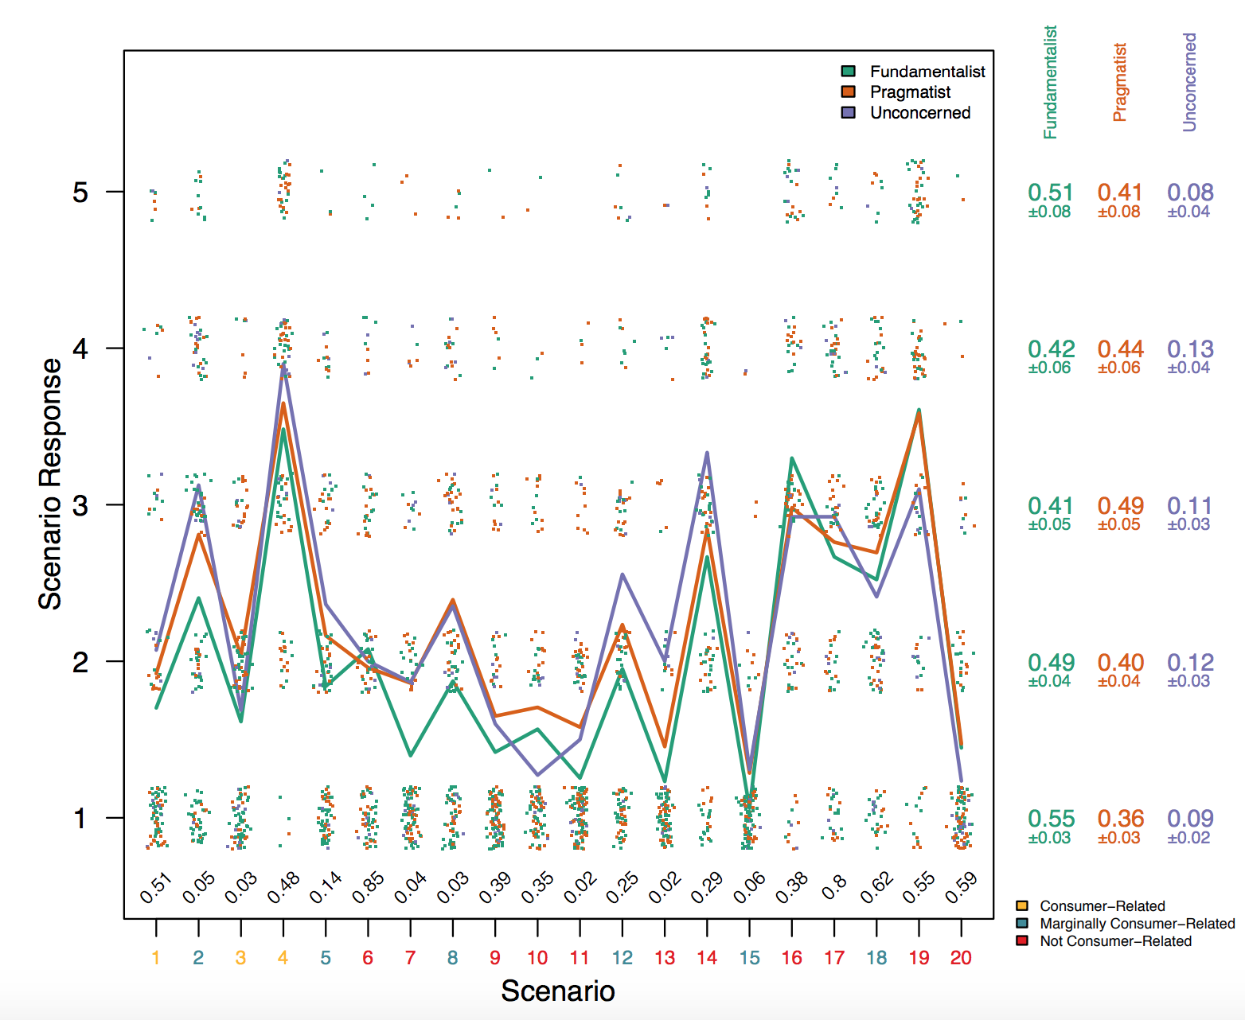
Westin Categories vs Scenario Response
Response: 5-point Likert scale, where 1 indicates ‘Not at all Likely’ to disclose and 5 indicates ‘Extremely Likely’ to disclose
No significant difference between the response from different categories
“How likely would you be to [perform a given action]?

Slide 36
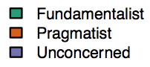
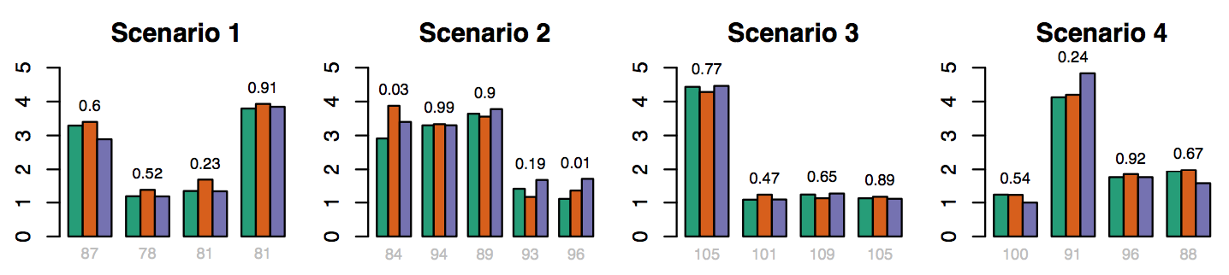
Scenario Outcome Analysis
The outcome response variable is the response to the question “How likely would you be to [disclosure specifics varied by scenario], knowing that this would be the only outcome?”
Westin’s categories doesn’t align with the outcome responses
you would expect bars of different colors having significantly different heights
e.g., fundamentalist reporting score close to 1 (not likely at all) whereas Unconcerned group reporting score close to 5 under specific outcomes (x-axis)

Slide 37
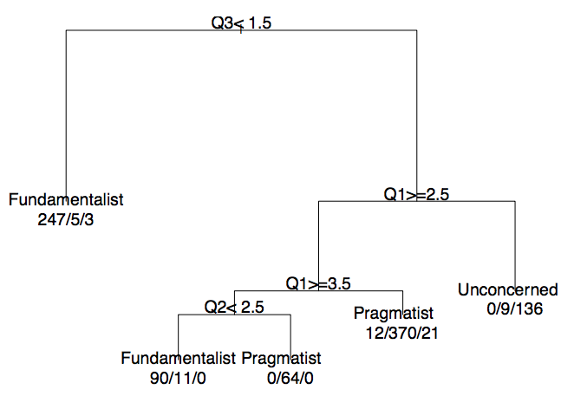
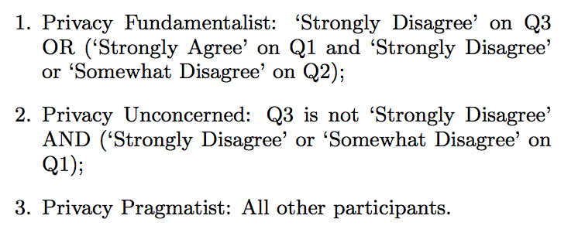
New Westin Segmentation Technique
Y
N
Y
N
Q1: Users lost control of data
Q2: Companies care about you
Q3: Enough law exists to regulate things
Y
N
Y
N
Likert scale of 1-4:
1: Strongly disagree

Slide 38
Impact of brand name
Understand whether making Westin questions more specific has an effect (mentioning specific brand like Amazon, PayPal, Safeway, Visa, and Walmart instead of generic ‘company’)
Survey with 6000 participants (GCS2 data set)
For the original Westin questions: 37% fundamentalists, 58% pragmatists and 5% unconcerned.
The proportion of fundamentalists was smaller for all brands (18% for Amazon and 34% for Walmart), with the proportion of unconcerned growing in all cases (to 25% for Amazon and 16% for Walmart).

Slide 39
Implications of the study
Negative result for Westin: No evidence to demonstrate correlation between Westin categories and
Behavioral intentions
Responses to consequences
Privacy segmentations (such as Westin’s) reach the limit for predicting privacy choices across diverse real life privacy conditions

Slide 40
Logistics
Home work 5 released. Due Nov. 06, @11:59pm
Best 4 out of 5 will count towards final grade.

Slide 41
Pop Quiz
10 min slot to finish before 11:59pm today
Link: https://bit.ly/3bWmTxV
Passcode: popquiz5

